Slide 1




.NET Community Austria February 2024
Presented by DotNetDevs.at
https://go.dotnetdevs.at/youtube
https://go.dotnetdevs.at/twitter
https://go.dotnetdevs.at/twitch
https://go.dotnetdevs.at/linkedin

Slide 2
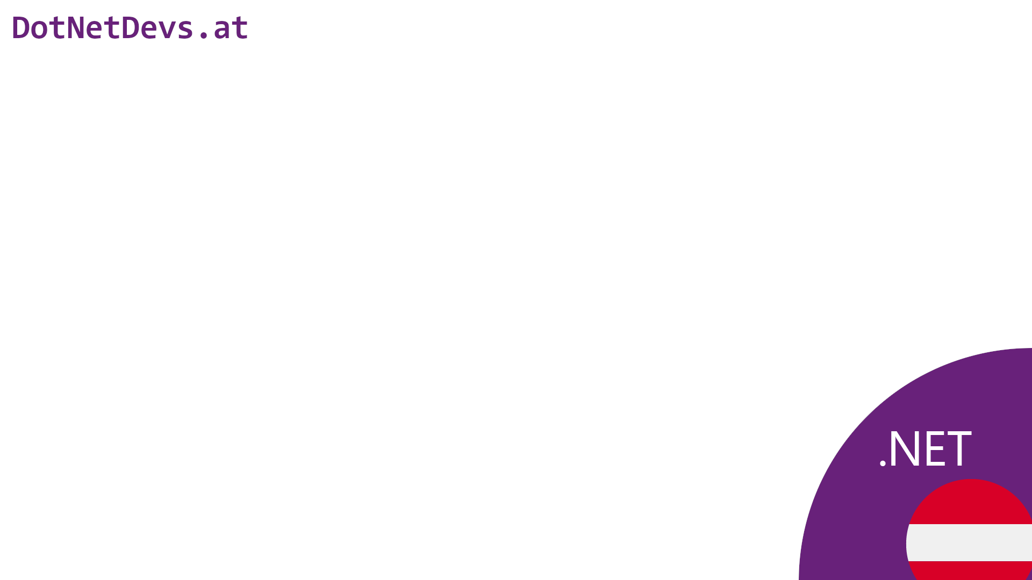
Thank you for joining!

Slide 3

Thanks for hosting!

Slide 4



Our Sponsors

Slide 5
How to take part in the raffle?
Type #jetbrains in the chat

Slide 6
Community News

Slide 7
Events
CoderDojo Wien - https://wien.coderdojo.net/ - March 1st & 15th
ComoCamp Collaborative Modeling Unconference- https://comocamp.org/ - May 6th-9th
Code/Crafts - https://code-crafts.com/ - May 16th

Slide 8
Next meetups
26th March 2024
Peter Melchart & Alex Gavrilescu
Real time 1v1 multiplayer game using .Net and Unity3D
Funstage
16th April 2024
Bas Dijkstra - Solving the integration testing puzzle with contract-based testing
Rubicon

Slide 9
GitHub Copilot – Gimmick or Useful?
Andreas Willich

Slide 10
GitHub Copilot - Gimmick or Useful?
Andreas “SabotageAndi” Willich

Slide 11


Slide 12
What is GitHub Copilot
cloud-based artificial intelligence tool
Technial Preview June 2021
Released June 2022
IDEs
Visual Studio Code
Visual Studio
NeoVim
JetBrains IDEs
Subscription Based (10€/19€/39€)

Slide 13

What GitHub Copilot isn’t
Notes:
Not Jarvis, you don’t give it the task to build XYZ and it auto magic builds it for you.
It can’t interpret

Slide 14

What GitHub Copilot is
Created by Dall-E: Prompt: different user interfaces
Notes:
It is a new kind of User interface
And we are not used to it!

Slide 15
Context, Context, Context!
What you tell Copilot directly
Setting the Stage
Ask simple and specific
Examples!
Open files

Slide 16
Where I use GitHub Copilot

Slide 17


Our IDEs
Notes:
Available in both, not all features in both

Slide 18
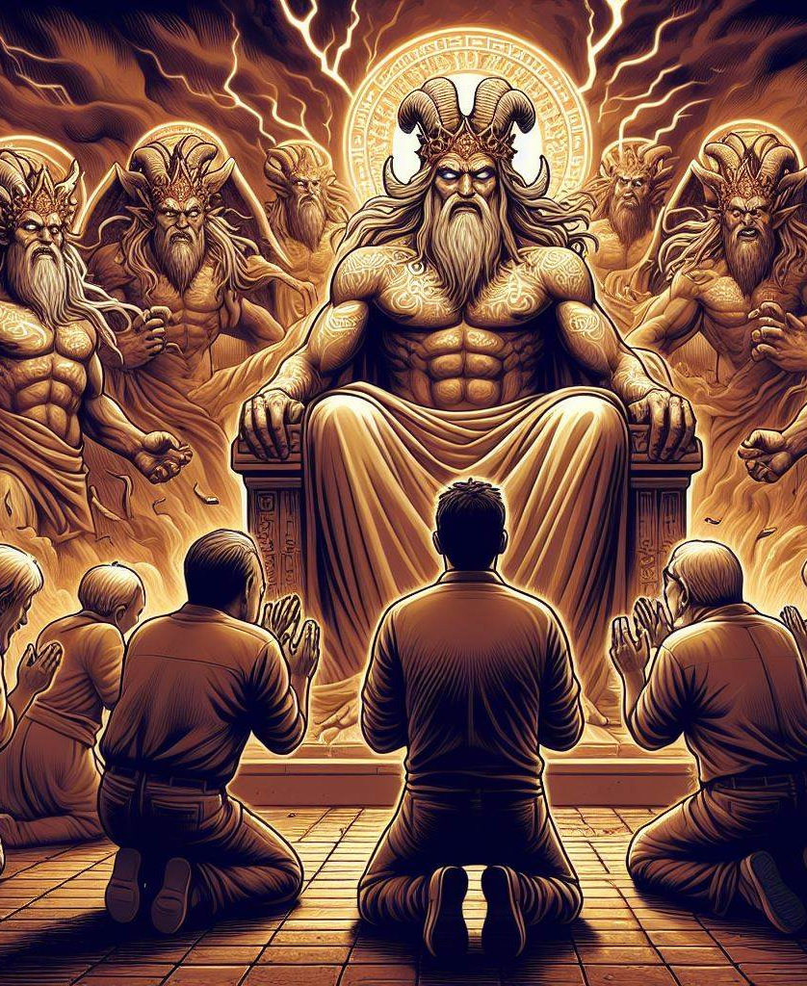
Pray to the Demo Gods!
Created by Dall-E: Prompt: people praying to the demo gods which look like zeus

Slide 19
Topics covered
ConsoleApplication245 replacement
Query Generation
Questions about Project
Questions about Code
Pipelines
PowerShell Scripts
Documentation
Commit message

Slide 20
TechTalk Usage
Exception Analysis
Spikes
Refactorings
Writing Boilerplate Code
Explore new Technologies

Slide 21
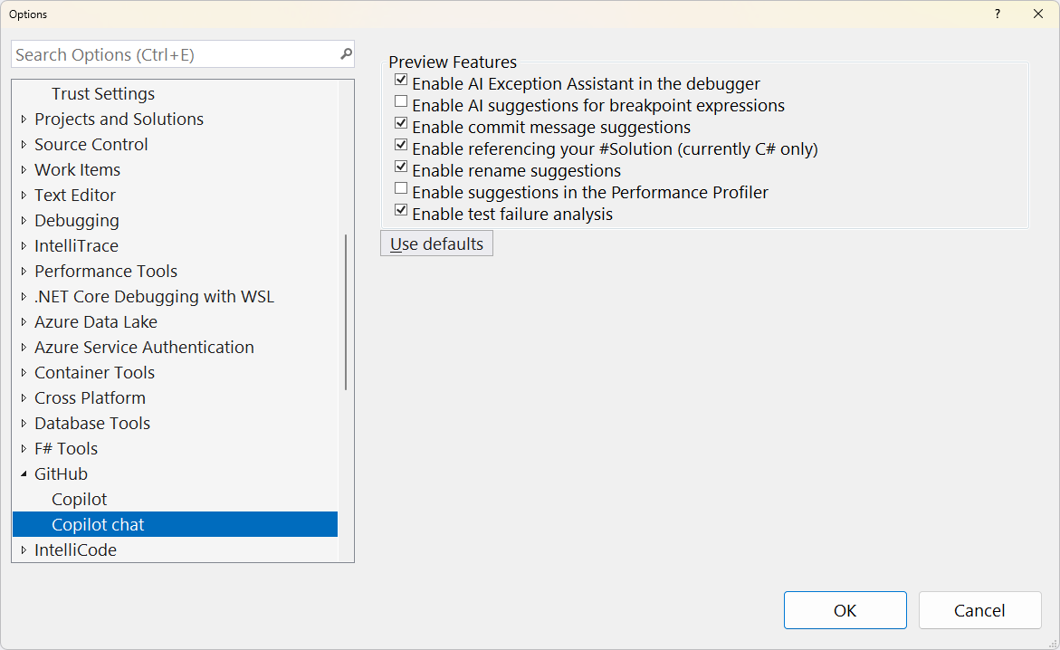
Renaming in Visual Studio

Slide 22
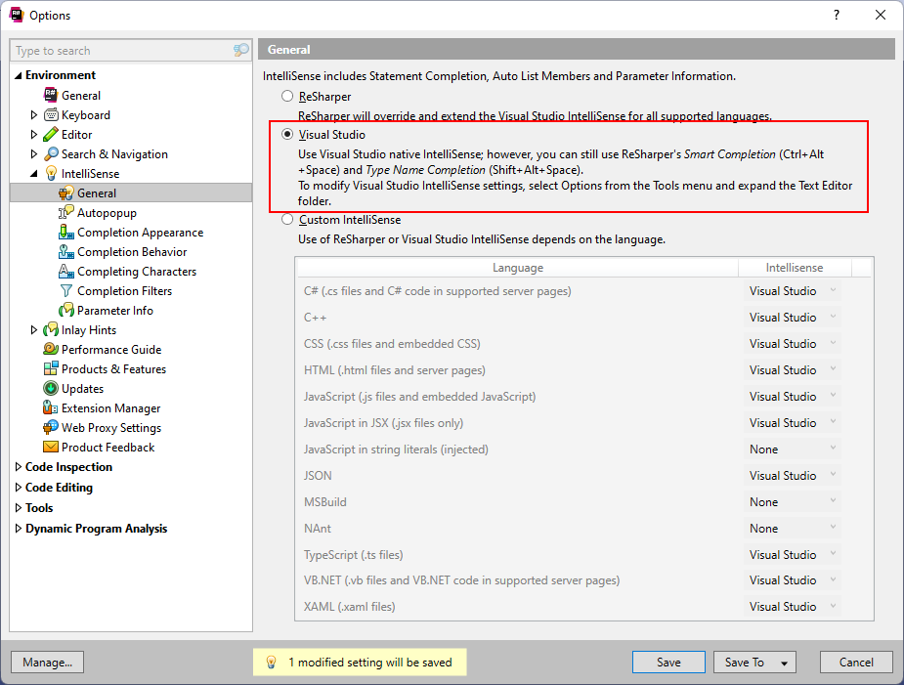
Together with R#

Slide 23
Gimmick or Useful?

Slide 24

Gimmick or Useful?
Created by Dall-E: smiling software developer with an extended arm and a thumbs up in a comic style

Slide 25
Copyright & Security

Slide 26
Copyright
Copilot Copyright Commitment
https://www.microsoft.com/en-us/licensing/news/Microsoft-Copilot-Copyright-Commitment
GitHub Copilot Trust Center
https://resources.github.com/copilot-trust-center/

Slide 27
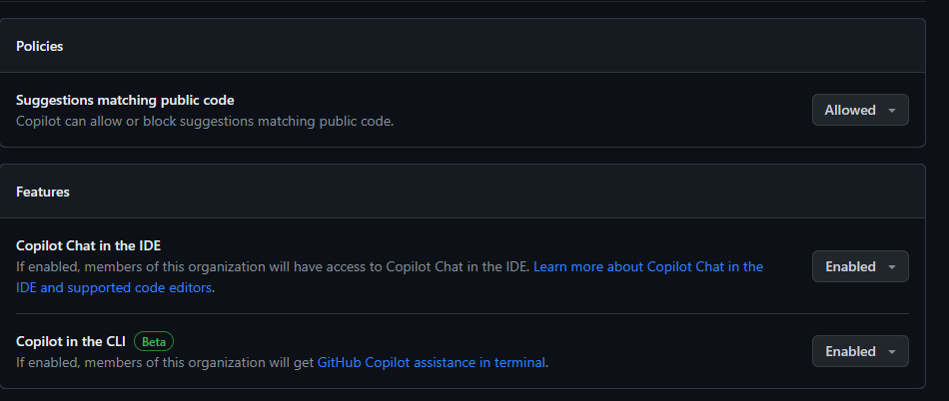
GitHub Copilot Settings

Slide 28
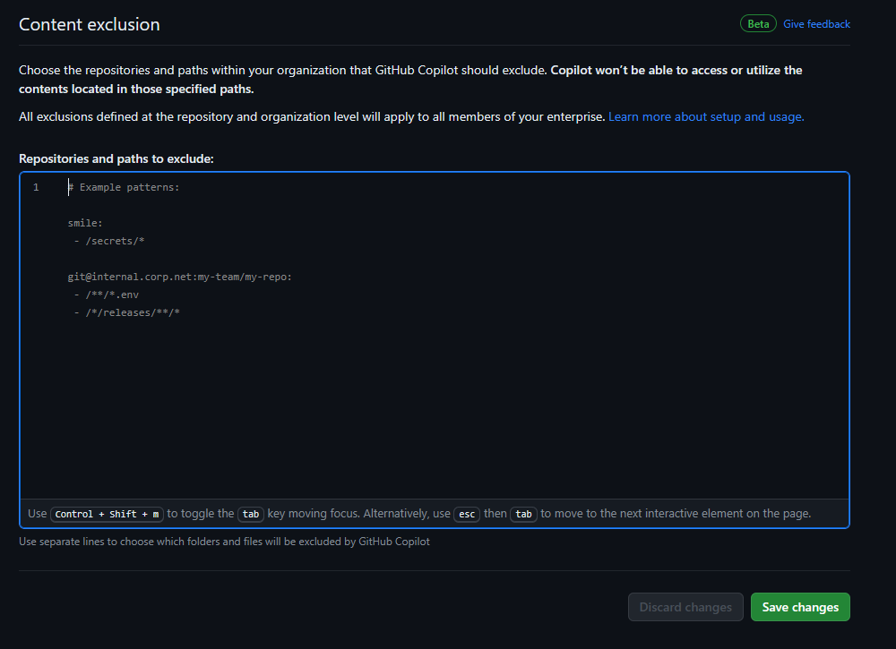
GitHub Copilot Settings

Slide 29
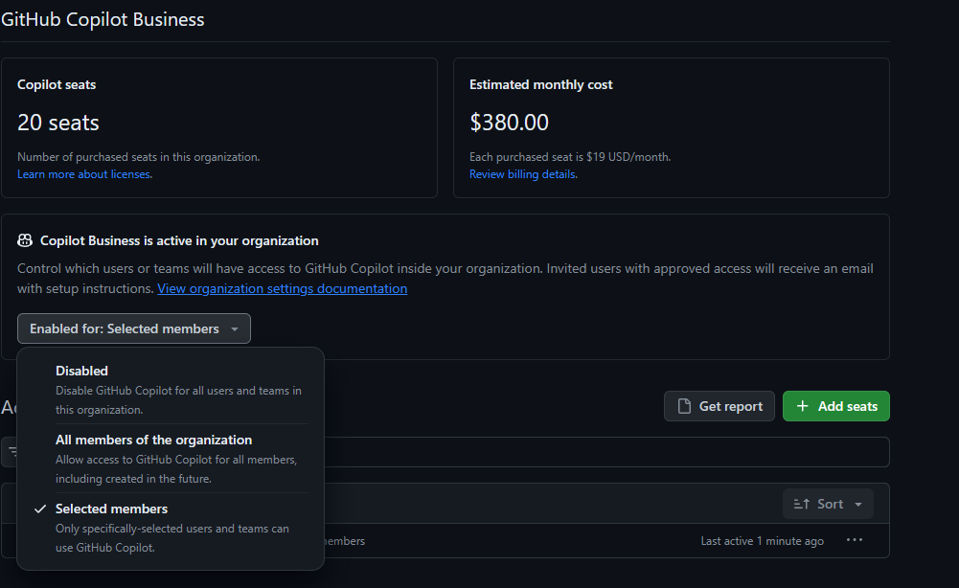
GitHub Copilot Settings

Slide 30
Thank you!
Which questions can I answer?

Slide 31
Our Sponsors

Slide 32
JetBrains Raffle
Contact us at team@dotnetdevs.at

Slide 33

We want to hear your feedback
https://go.dotnetdevs.at/feedback-202402

Slide 34
See you March 26th!
Real time 1v1 multiplayer game using .Net and Unity3D
Peter Melchart & Alex Gavrilescu @ Funstage

